Slide 1















Project Proposal Presentation, Oct 4th, 2024
Housit- hows it?
:HouseCare Mobile Application
Team A : A+
Minsoo KIM, Seoyoung JO, Seoyoung JIN,
Jinwook CHOI, Sooyoung HWANG

Slide 2

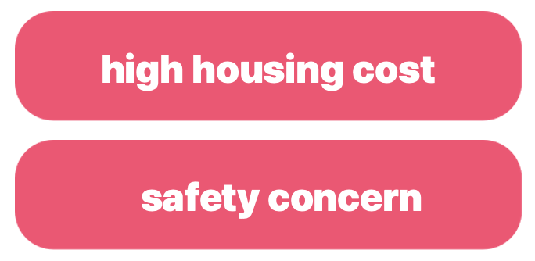















Needs(What & Why?)
one-person household
Co-Living
Task-sharing
Expense
Schedule-sharing
Grocery
Check assigned chores
Prevent conflict with
fair distribution
Provide transparent way
to handle shared cost
Keep tracking how much we costed and saved
Plan monthly expense
Coordinate and schedule
communal events
Efficient tracking of shared grocery
Reduce food waste
We create, record, share, and re-find daily information everyday.
BUT, information is dis-organised and scattered.
-> Difficult to find and understand the information you need.

Slide 3







Related Works
Household Accounting App
Flatastic
When does it expire?
: Share Living Application
: Food Management
: Finance
Food management X
Auto adding for product name
Limitation: number of member
Expense :
recording account balance X
Manually input expiration date
Invite member for sharing X (compared in the table as followed in next, next slide)
Chores :
Descriptions for cleaning areas X

Slide 4





Related Works
Kakao Talk
& Google Calendar
Tody
: Cleaning management
: Event Management
Create specific cleaning area
Set dates, times, notifications
Invite communal members
for cleaning
Shared calendar functionality
Need: Assigning areas
beforehand

Slide 5
Related Works : limitations
Incompleteness : each app doesn't provide the specific features you need
Scattered : lack of integration, forcing you to sign up for and use multiple apps
Poor usability : uncomfortable UI/UX

Slide 6
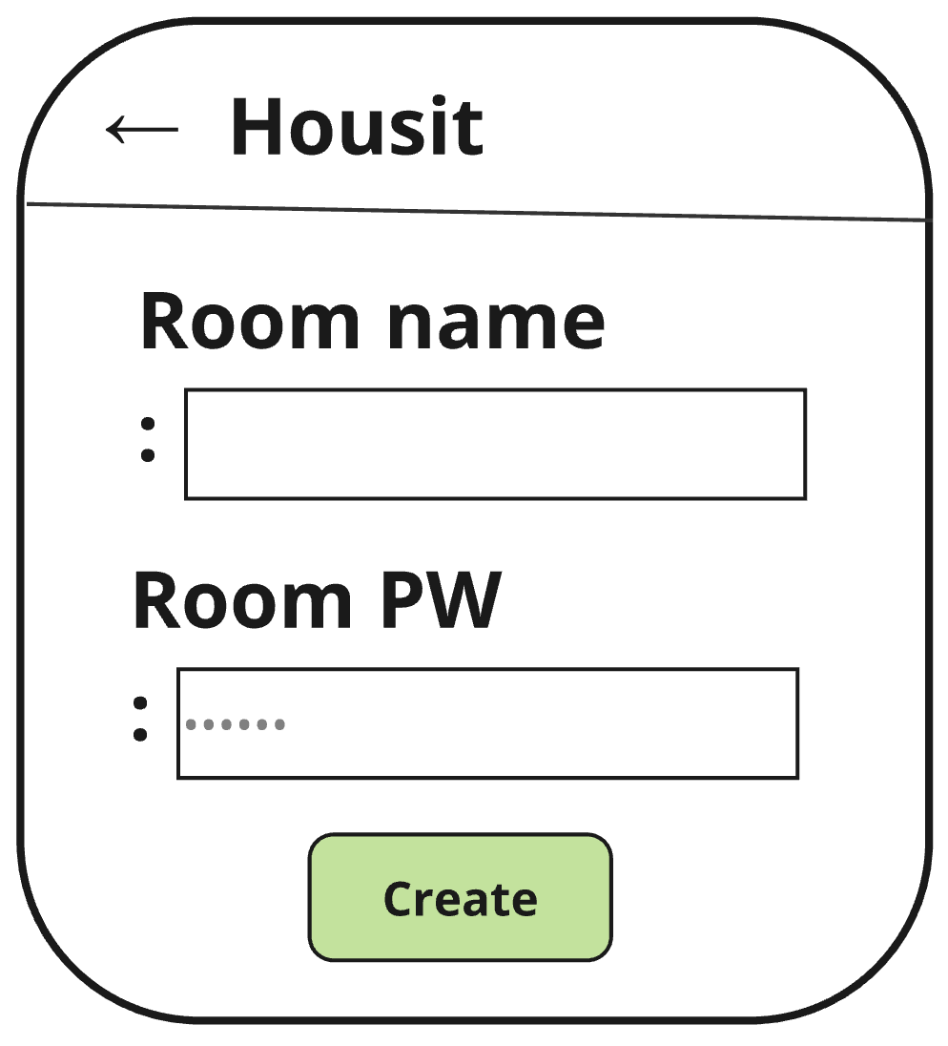
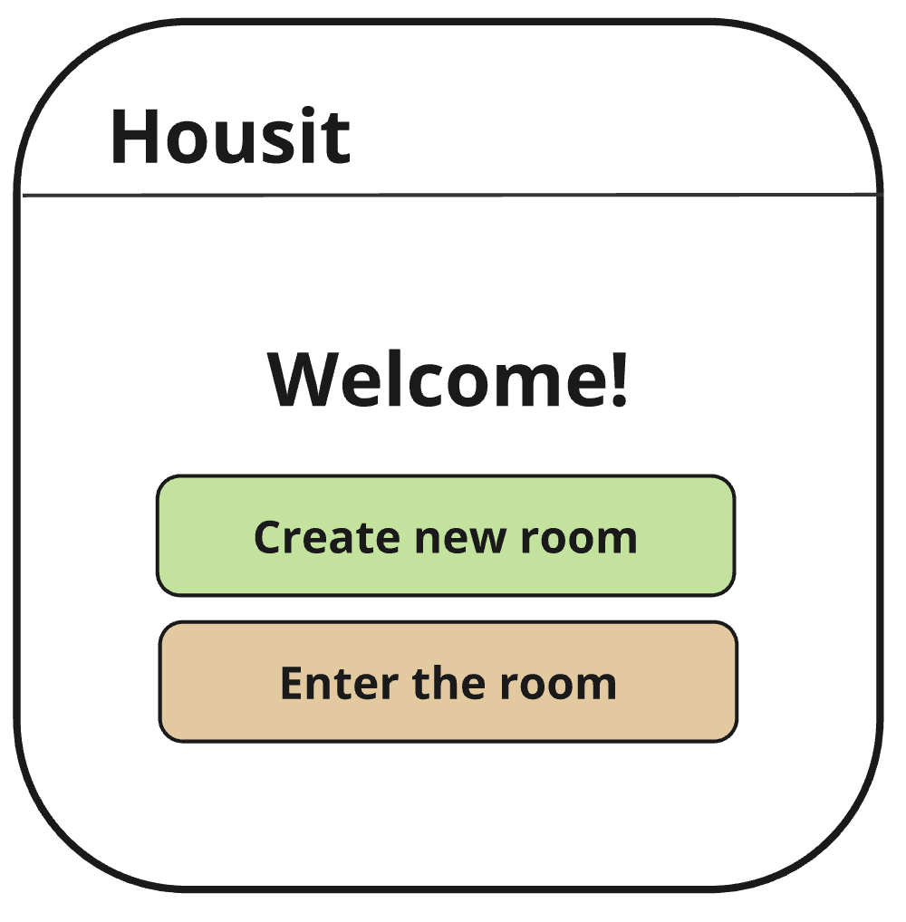
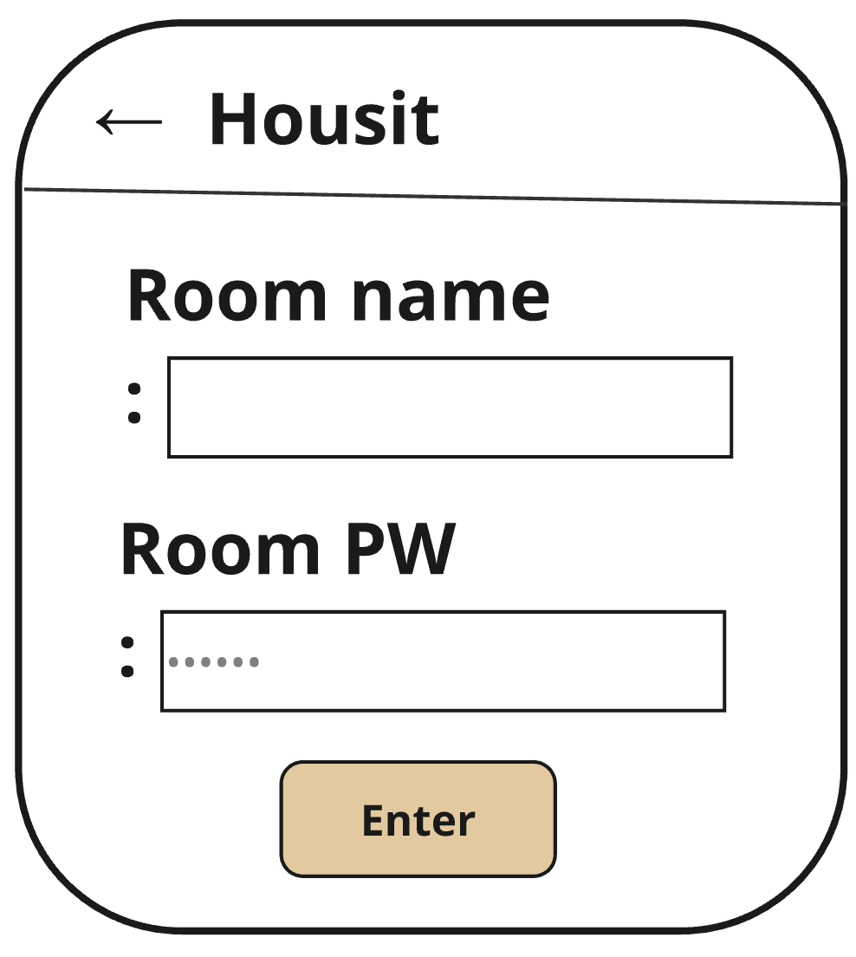
Solutions: Rooms
Key features
Create a room
Share the room name(ID) and PW with our co-living members
Each room has sub-users
Room PW is mandatory with 6 pin numbers and sub-users PW is optional with 4 pin numbers.
Ban feature for preventing from strangers
Room manager has the permission.
Mandatory process to change the Room PW after banning a stranger.

Slide 7
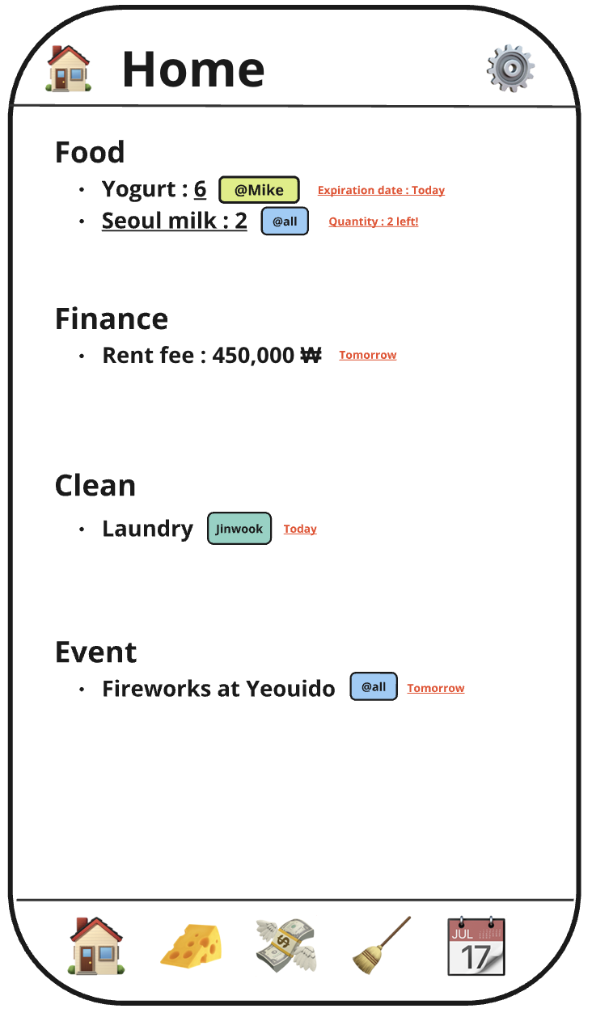
Solutions: Home
Key features
Displaying most important information of household
Food
Expiration Date
Favorite food : Minimum quantity
Finance
Due date of fixed expense
Clean
Due date of cleaning area
Event
Upcoming events

Slide 8
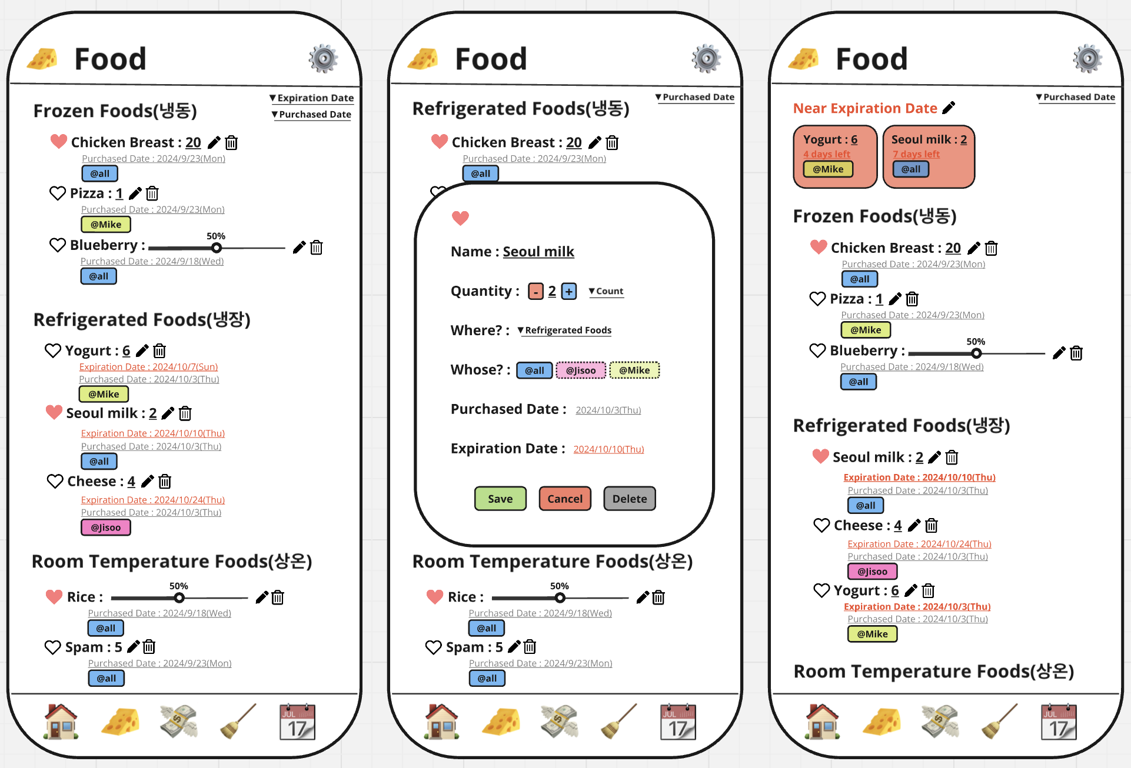
Solutions: Food
Key features
Add/delete/modify food items
Grouping/Filtering/Sorting
Refrigeration/ Frozen/ Room Temperature food
Shared/ Private food
Expiration date
Purchased date
Scan and auto-add expiration date to the items(OCR)

Slide 9
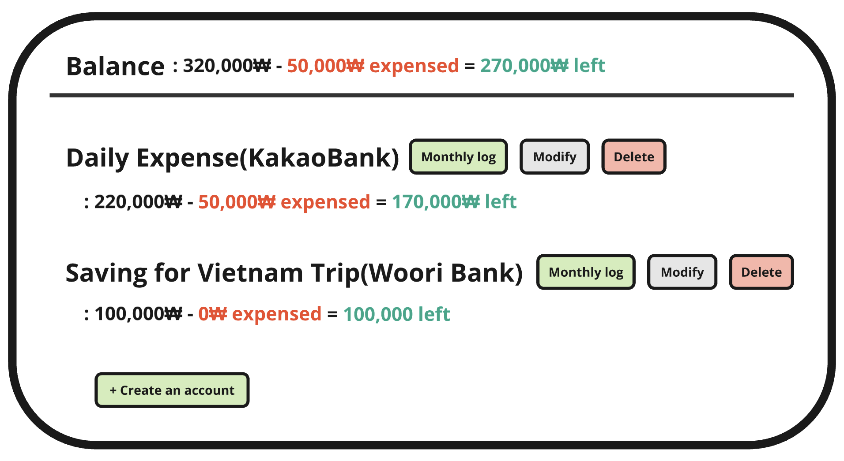
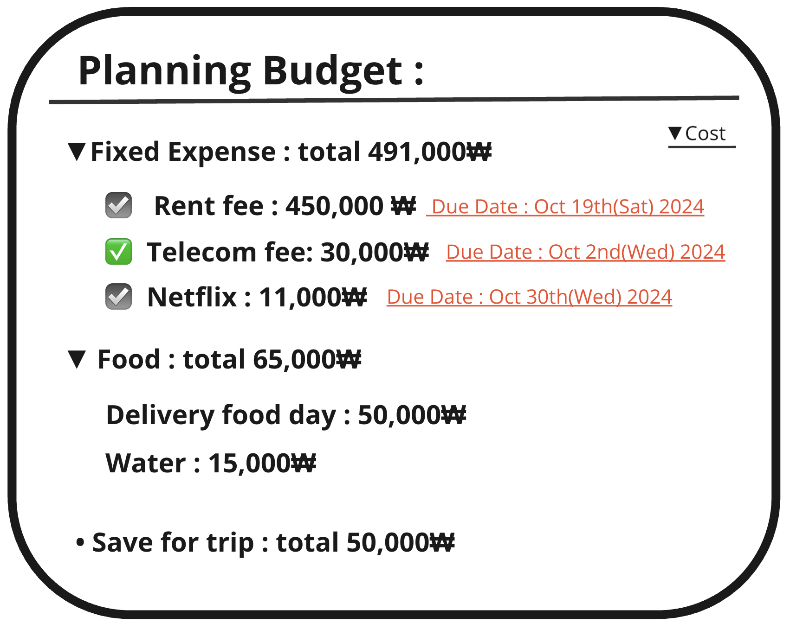
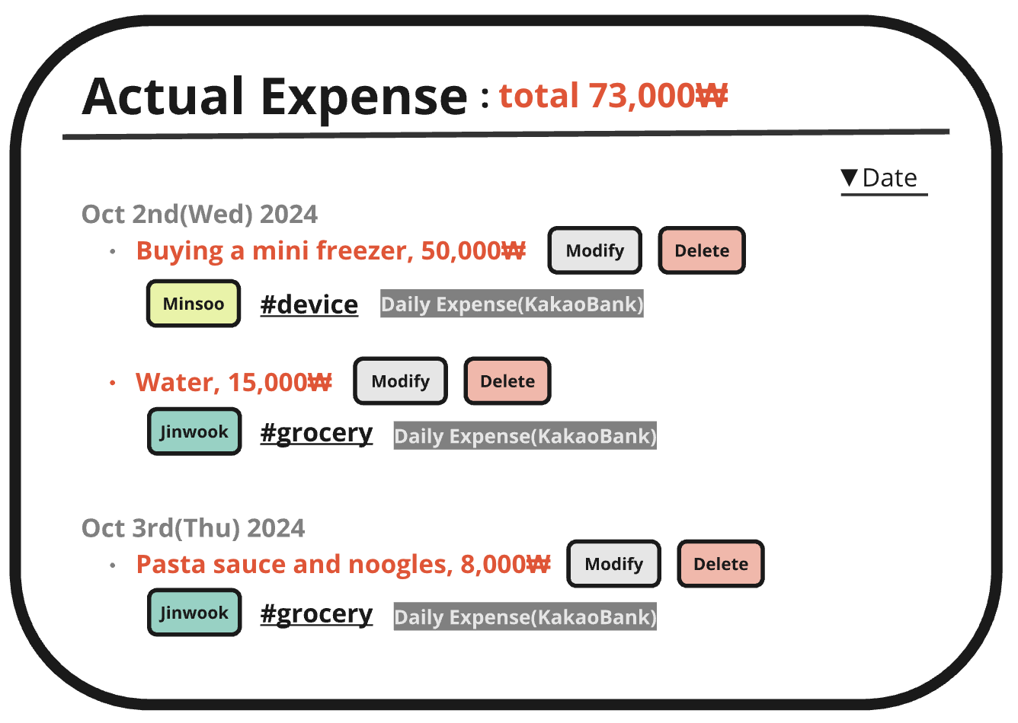
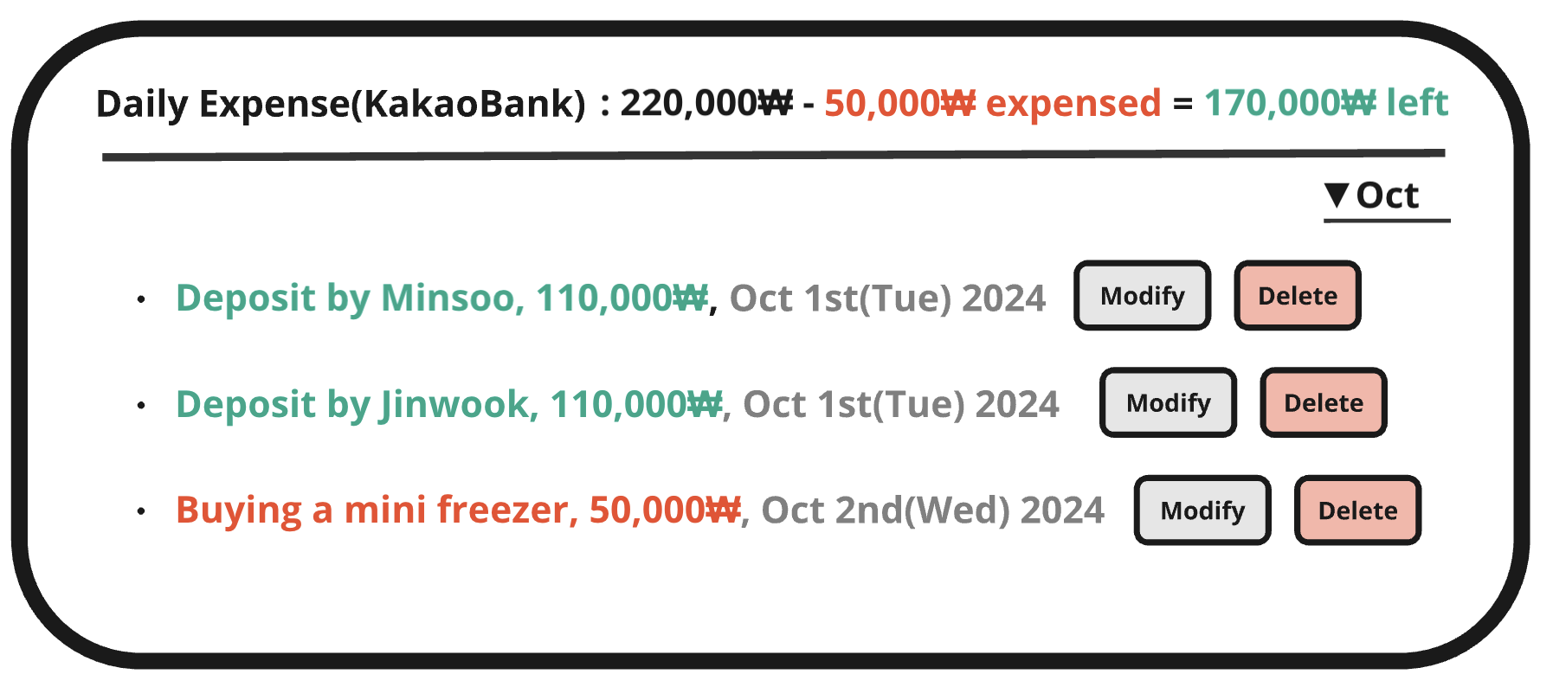
Solutions: Finance
Key features
Planning Budget
Make categories/sub-categories
Fixed Expense
Checkbox and Due date feature
Actual Expense
Keep tracking actual expenses
Select who payed, expense categories and bank account from where the money came
Balance
Add a bank account
Modify the name
Tracking income/outcome logs

Slide 10
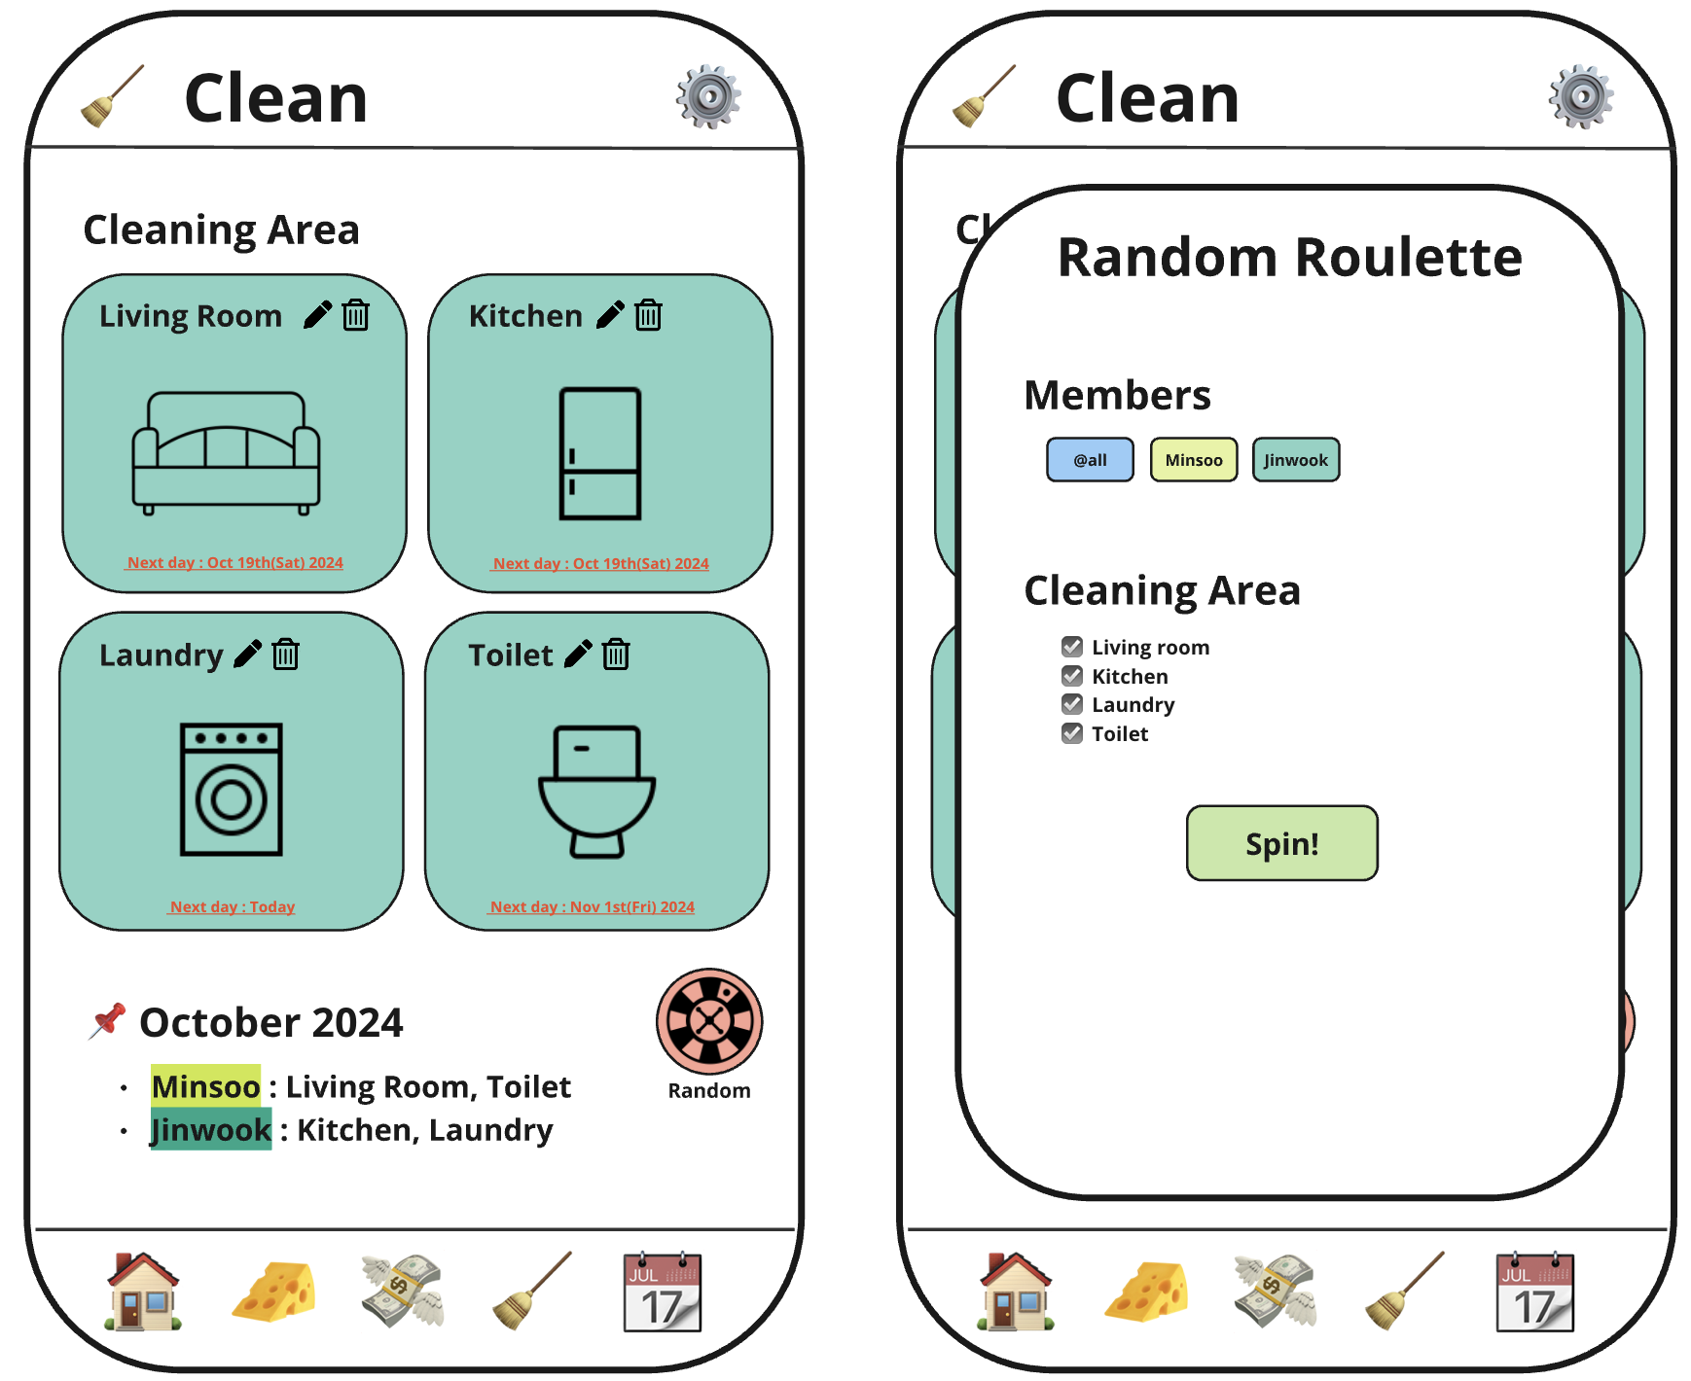
Solutions: Clean
Key features
Write/modify descriptions about cleaning areas
Set the cleaning period(frequency) and notify when it comes
Roulette button for randomly assigning new areas every month

Slide 11
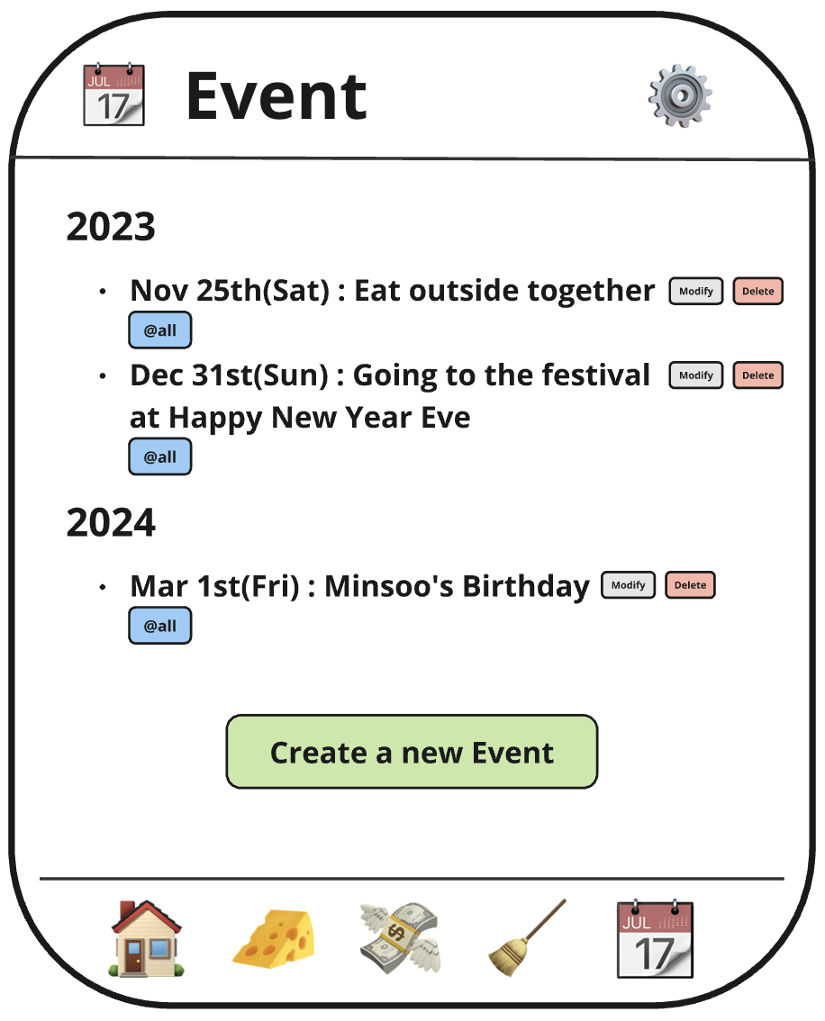
Solutions: Event
Key features
Add/Modify shared event
Tag the members who will be participated in the event
Notify to the Home view when the day comes

Slide 12

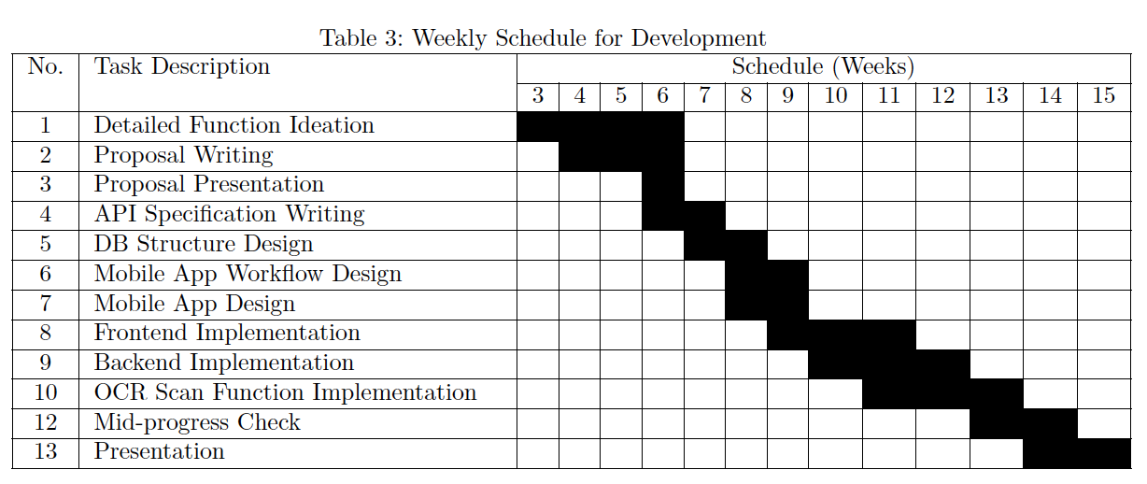
Role & Plan
Name | Role
김민수 | Planning, Document, UI/UX
조서영 | OCR Feature Implementation
진서영 | UI/UX Design
최진욱 | Frontend
황수영
Backend

